Slide 1
ClimateWins Using machine learning to predict climate change consequences
Interim Report, Joan Gandy, 01/05/2024

Slide 2
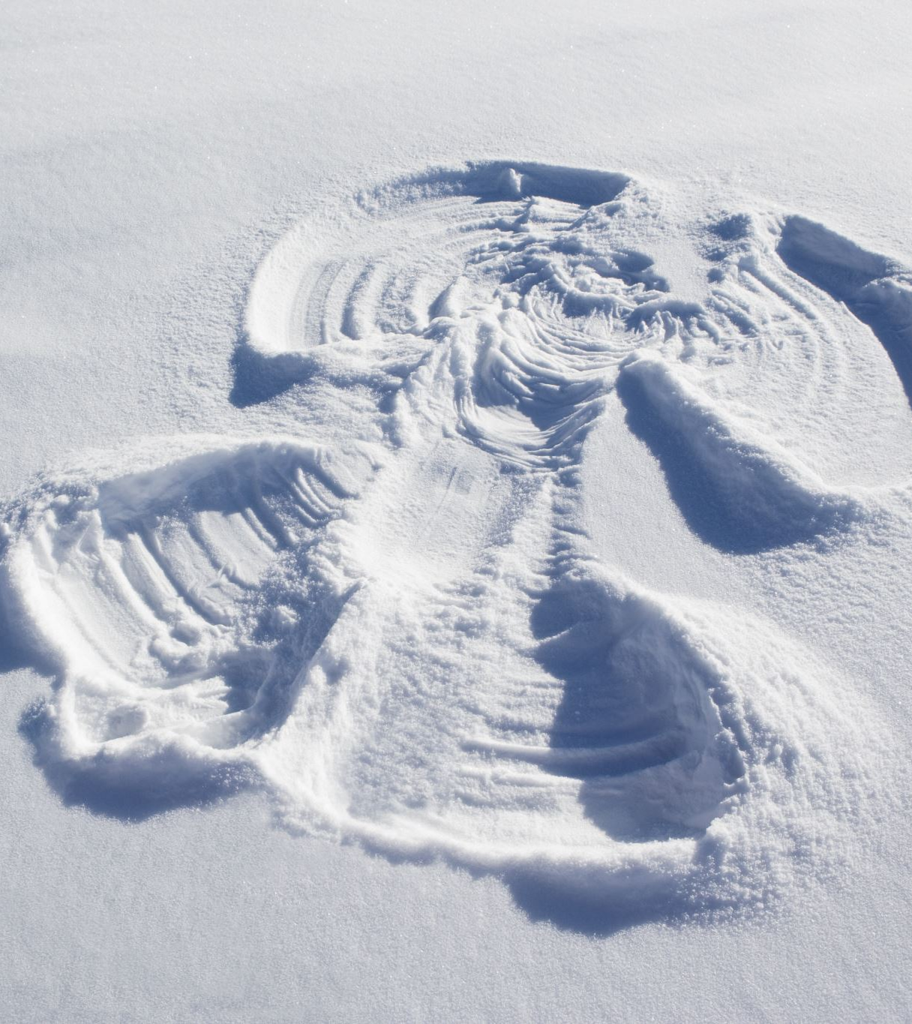
Question #1 Can pleasant weather be forecasted?
Tested using three machine learning models
Used European Climate Assessment Data Set
Temperature, wind speed, snow, global radiation from 18 European weather stations from 1960-2022
Hypotheses
#1. The model that best predicts pleasant weather will predict consequences of climate change most accurately.
#2. Mean temperatures will have risen at all weather stations from 1960-2022.
#3. K Nearest Neighbor model will predict pleasant weather more accurately than other models.

Slide 3

Data Bias and Accuracy
Accuracy
Improvements in technology mean older data may be less accurate than more recent data.
Location Bias
Data is geographically limited to 18 European weather stations. Results not applicable to global weather patterns.
Analysis Bias
Pleasant weather is defined by ClimateWins as weather where people are comfortable participating in typical outdoor activities. However, this is a subjective definition.

Slide 4
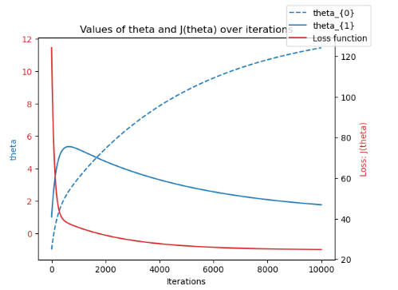
Data Optimization
Gradient Descent Methods
Results
Find the optimal weights and biases that minimize the loss function.
Tested on three stations’ average temperature for years 1960, 1990, and 2000
Iterations between 100 and 10,000
Step sizes between .001 and .1
Theta0 and Theta1 between -1 and 1
Loss function drops quickly to zero using 10,000 iterations, thetas -1 and 1 and a 0.001 step size for Madrid average temperature in 2000. Similar results from other cities and years

Slide 5

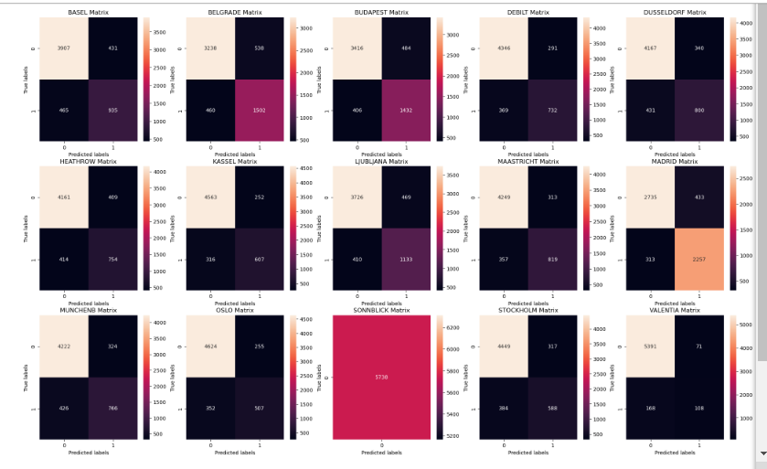
K Nearest Neighbor
Methods and Results
Tested with neighbors between 1 and 4
Average accuracy rate = 88%
General conclusions
Accuracy varied from a low of 83% at Belgrade to 100% at Sonnblick weather station
The 100 percent accuracy of the Sunnblick data suggests the model is overfitting. The model may be influenced too much by noise resulting in its over performance on the training data and under performance on new data. The model may not be able to generalize to other datasets.
It will be important to diversify and broaden the training data if this model is to be used to make future weather predictions.
Overall, the 88 percent accuracy means the model has a strong foundation but needs improvement.
City | Accurate 0 | Accurate 1 | False - | False + | Accuracy Rate
Basel Matrix | 3907 | 935 | 431 | 465 | 84%
Belgrade | 3238 | 1502 | 538 | 460 | 83%
Budapest | 3416 | 1432 | 484 | 406 | 84%
Debilt | 4346 | 732 | 291 | 369 | 88%
Dusselfdorf | 4167 | 800 | 340 | 431 | 87%
Heathrow | 4161 | 754 | 409 | 414 | 86%
Kassel | 4563 | 607 | 252 | 316 | 90%
Ljublijana | 3726 | 1133 | 469 | 410 | 85%
Maastricht | 4249 | 819 | 313 | 357 | 88%
Madrid | 2735 | 2257 | 433 | 313 | 87%
Muchenb | 4222 | 766 | 324 | 426 | 87%
Oslo | 4624 | 507 | 255 | 352 | 89%
Sonnblick | 5738 | 0 | 0 | 0 | 100%
Stockholm | 4449 | 588 | 317 | 384 | 88%
Valentia | 5391 | 108 | 71 | 168 | 96%

Slide 6
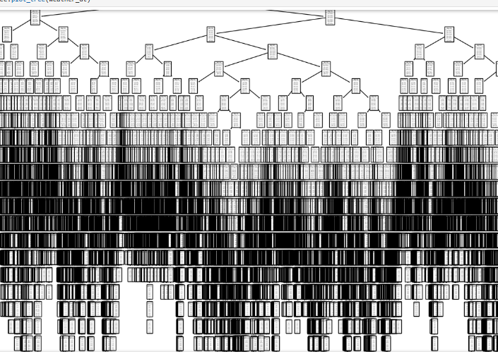
Decision Tree Algorithm
Accuracy rate of only 47%
Model would need to be substantially pruned or more data collected to improve accuracy
Decision Tree model not ideal for ClimateWins

Slide 7
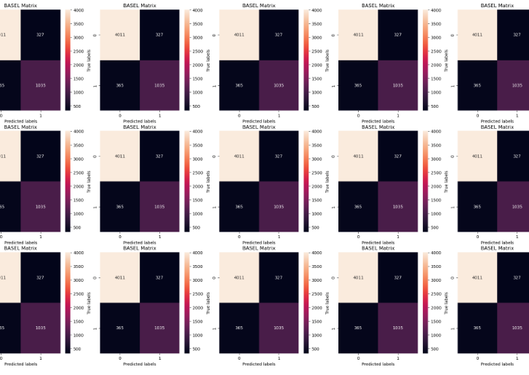
Artificial Neural Networks
Test parameters
Hidden layers between 2 and 3
Nodes (10, 5), (10, 5, 5), (10, 10, 10), and (15,15,15)
Max iterations between 500 and 1000
Results
Test accuracy between 47% and 48%
Model did perform well enough under any scenario to be used to predict future weather events

Slide 8

Moving Forward Question #2 Can changes in weather due to climate change be predicated using machine learning?
The K Nearest Neighbor model should be used to assess if machine learning can be used to predict future weather events based on past weather data.
K Nearest Neighbor had highest accuracy results of three models tested
Additional data on weather events from more geographical locations is needed to correct overfitting of model.
Hypotheses to test
#1. Adding additional data will improve accuracy of KNN model and correct for overfitting.
#2. KNN model will be able to predict likelihood of extreme weather events based on historical data.

Slide 9
Questions?
Joan Gandy
Cell: XXX-XXX-XXXX
Email: XXXXX@gmail.com

